Slide 1

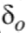
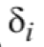

=15.7cm
w2
=18.0cm
=9.0cm
C
=25.8cm
a2
=8.3cm

Slide 3
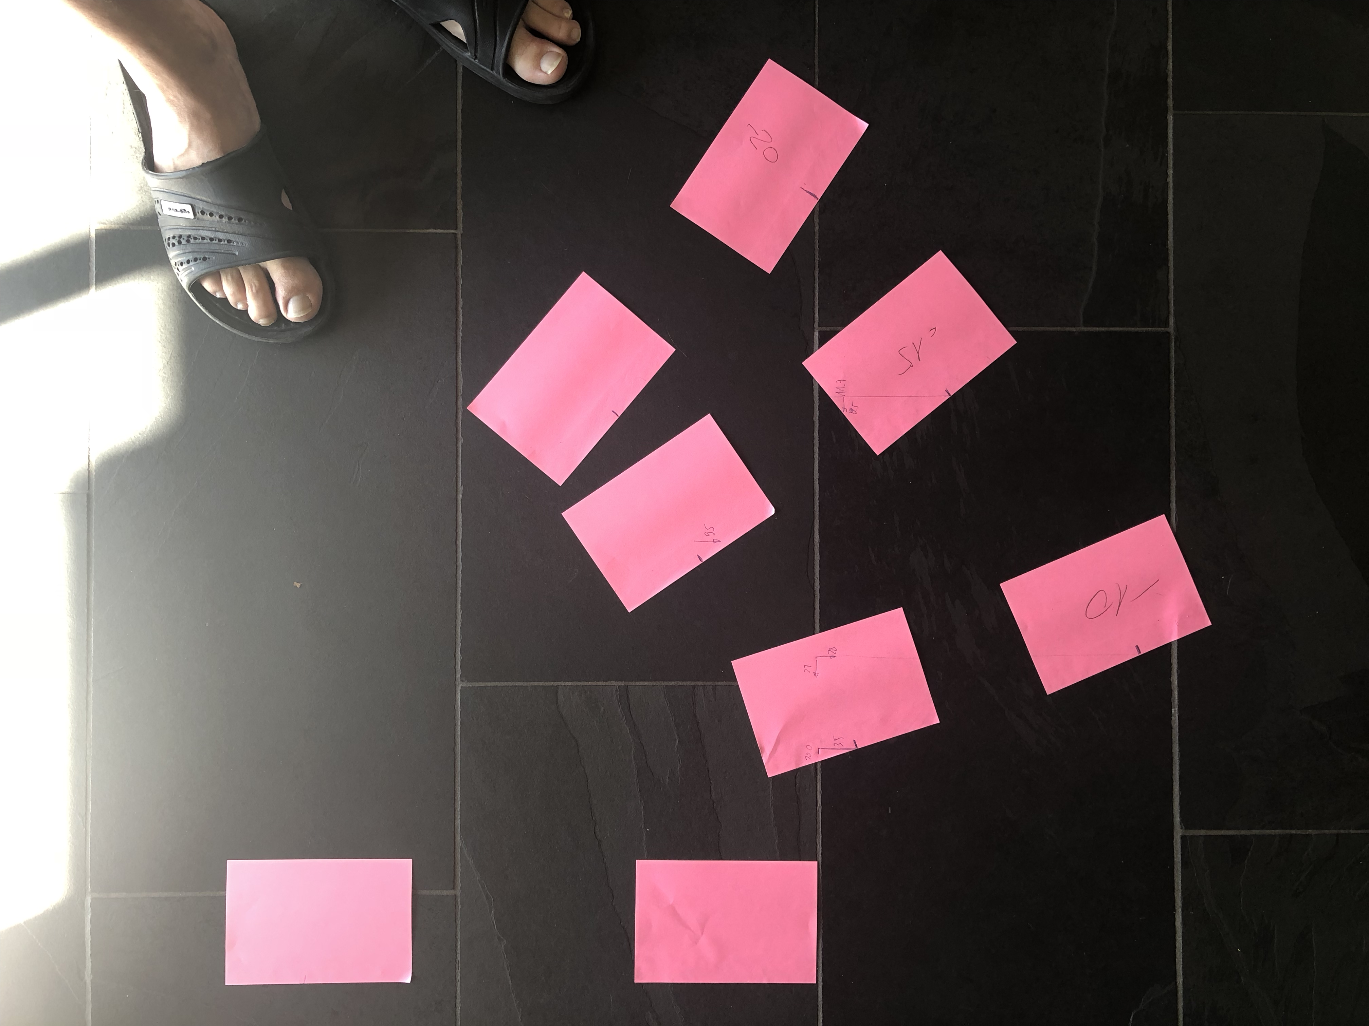

Slide 6
